Slide 1
ClusterFL: A Similarity-Aware Federated Learning System for Human Activity Recognition
Xiaomin Ouyang, Zhiyuan Xie, Jiayu Zhou, Jianwei Huang, Guoliang Xing
The Chinese University of Hong Kong
Presented by Rui Chen
MobiSys 2021

Slide 2
Outline
Motivation
Similarity-aware federated learning framework
Experimental Results
Conclusion

Slide 3



Motivation – Human Activity Recognition
Fitness Tracking
Sleep Monitoring
Health monitoring
Notes:
Federated learning is promising to make application more intelligence

Slide 4


Motivation - Centralized Deep Learning
- Significant privacy concern (send raw data)
Server
How about keep the data locally?

Slide 5
Motivation– Federated Learning
Collaboratively training while keeping the data residing on devices.
There is a high degree of data heterogeneity of human activity data.
Server
A new global model

Slide 6
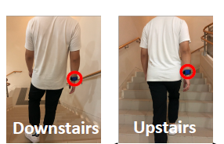
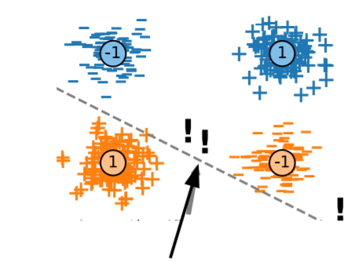
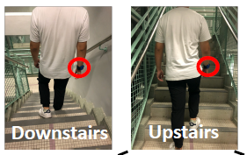
Challenge – User Heterogeneity
In this situation, a single linear classifier can not simultaneously be correct for all clients.

Slide 7
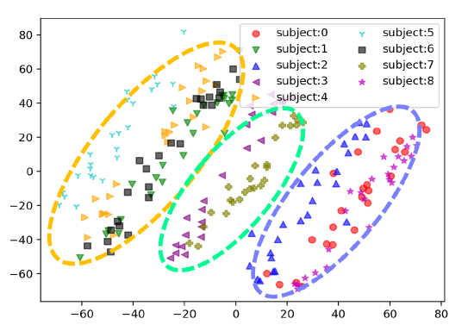
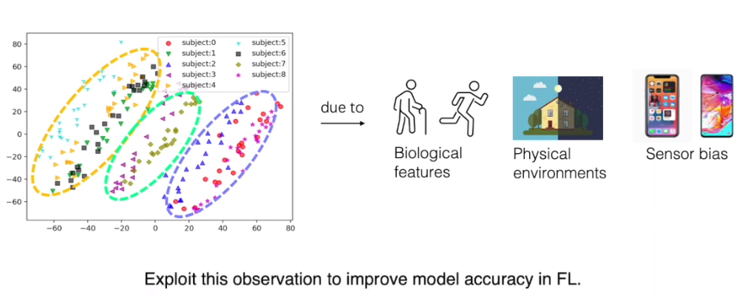
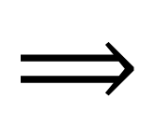
Motivation
- There exhibits intrinsic similarities among users’ activities.
due to
$$⟹$$
A clear clustering relationship among subjects in the walking dataset, where the data from the same type of smartphone is grouped to the same cluster.

Slide 8
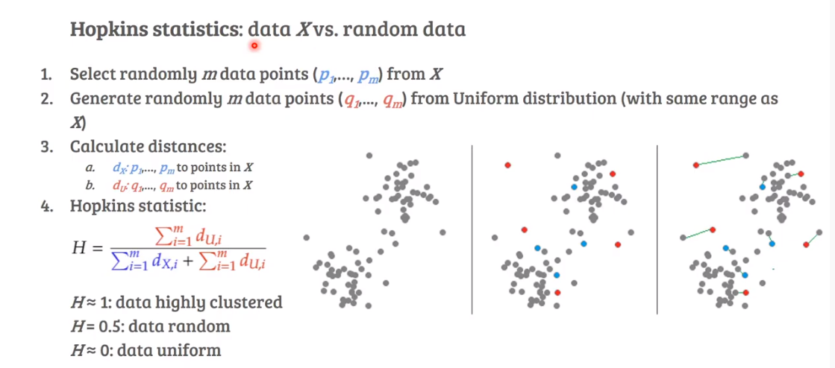
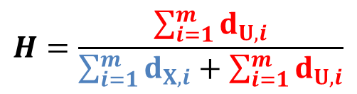
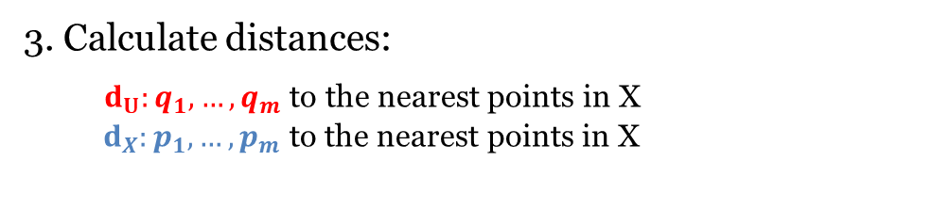
Motivation – Clusterability on Learning
Hopkins statistic: data X vs random data
1. Blue data points ($p_{1},…,p_{m}$) randomly selected from X;
2. Red data points ($q_{1},…,q_{m}$) randomly generated from Uniform distribution.
3. Calculate distances:
$d_{U}:q_{1},…,q_{m}$ to the nearest points in X
$d_{X}:p_{1},…,p_{m}$ to the nearest points in X
4. Hopkins statistic
$$H=\frac{\sum_{i=1}^{m}{d_{U,i}}}{\sum_{i=1}^{m}{d_{X,i}}+\sum_{i=1}^{m}{d_{U,i}}}$$
data X

Slide 9
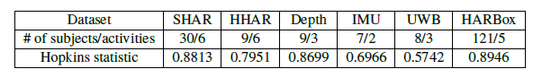
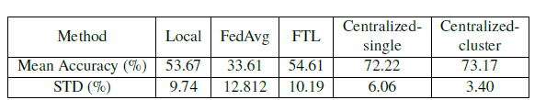
Motivation – Clusterability on Learning
Empirical studies
- Quantifies the clustering tendency of HAR data
Grouping helps!
- The Centralized-cluster method has the best performance
Nodes share a global model

Slide 10
Contribution
propose ClusterFL, a similarity-aware federated learning system to enable collaborative learning among similar nodes.
introduce two communication efficient strategies: cluster-wise straggler dropout and correlation based node selection, based on the learned cluster structure.
collect four new human activity recognition (HAR) datasets in different environments with significant dynamics

Slide 11
Outline
Motivation
Similarity-aware federated learning framework
Experimental Results
Conclusion

Slide 12
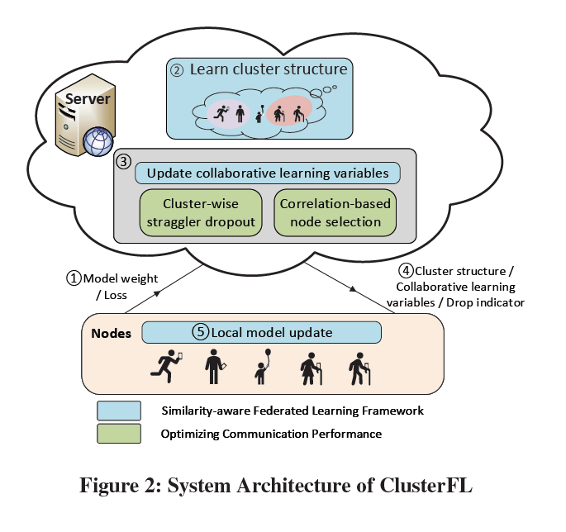
Similarity-aware FL Framework
Step 1: Nodes upload local model weights/loss
Step 2: The server use a cluster indicator matrix to quantify the clusters
Step 3: Based on the learned cluster indicator matrix, the server updates the models and identify cluster-wise slow/less important nodes
Step 4: The updated models and a drop indicator are send back to nodes
Step5: Nodes perform the local training

Slide 13
Similarity-aware FL Framework
Similarity-aware FL framework
How to identify clusters
How to update model

Slide 14
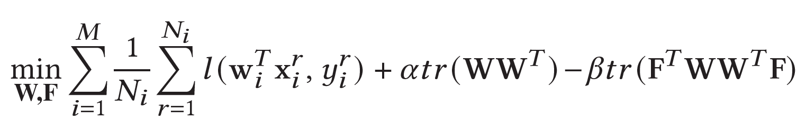
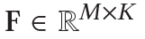
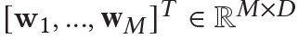
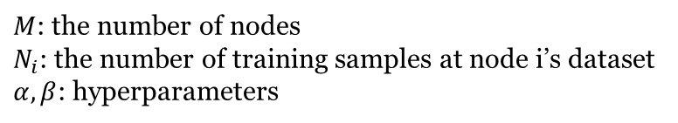
Similarity-aware FL Framework
The global objective of ClusterFL
cluster indicator matrix
Local model
Customize a model for each node
L2-Regularization
K-means clustering
Learn from the same cluster
$M$: the number of nodes
$N_{i}$: the number of training samples at node i’s dataset
$α, β$: hyperparameters
Notes:
Different from the original fl model to train a single model!
Preserving the similarity of model weights of nodes in the same cluster.

Slide 15
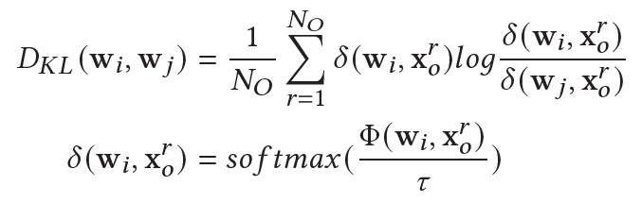
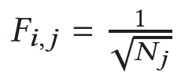
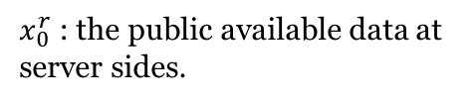
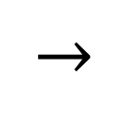
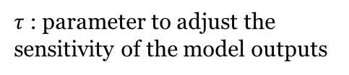
Similarity-aware FL – Alternating optimization
$x_{0}^{r}$ : the public available data at server sides.
Fixed W, optimize F
$$→$$
$τ$: parameter to adjust the sensitivity of the model outputs
via the similarity of the node models
pre-softmax output of model
𝐾-means clustering
Unknown
if node i belongs to j-th cluster and $Fi, j = 0$ otherwise

Slide 16
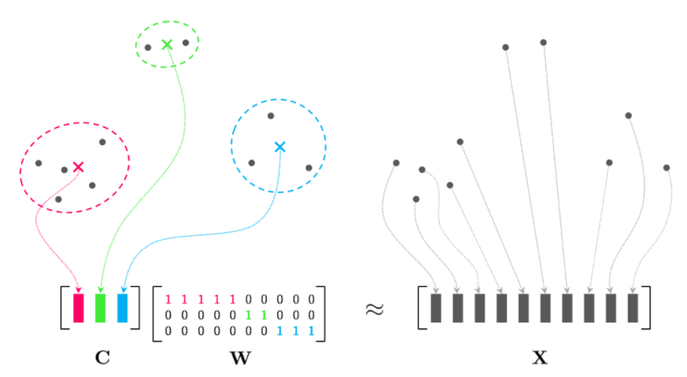
Similarity-aware FL -- Cluster indicator
𝐾-means clustering
Unknown number of clusters K
Solution¹:
principal components analysis (PCA)
¹ Ding et al. K-means clustering via principal component analysis. 2004

Slide 17
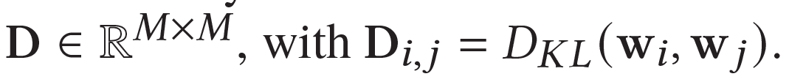
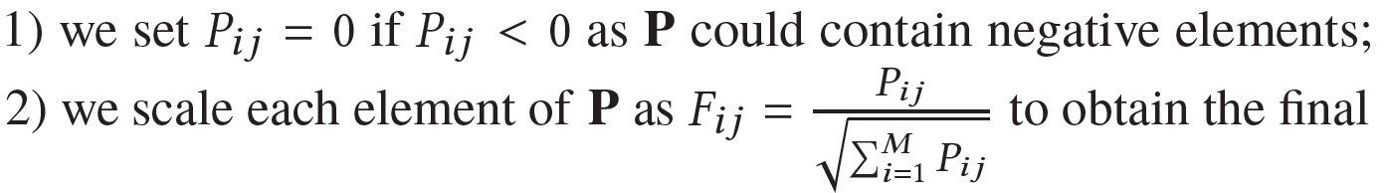
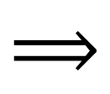
Similarity-aware FL -- Cluster indicator
Fixed W, optimize F
Solution¹:
Based on the KL divergence matrix
Normalized indicators F
M-1 principal components
$$⟹$$
(
)
P is the continuous solution of K-means clustering to approximate F. ¹
¹ Ding et al. K-means clustering via principal component analysis. 2004

Slide 18
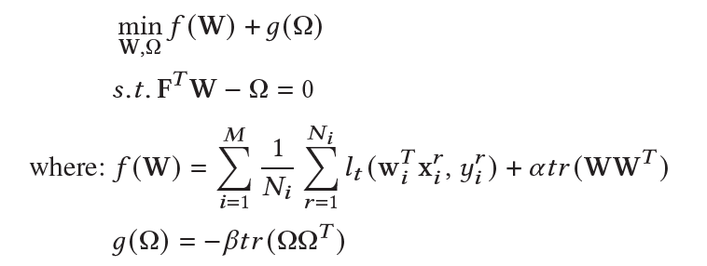
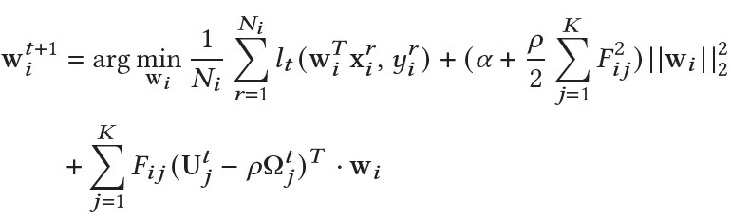
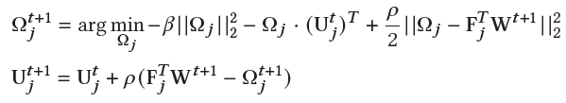
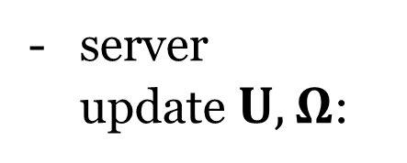
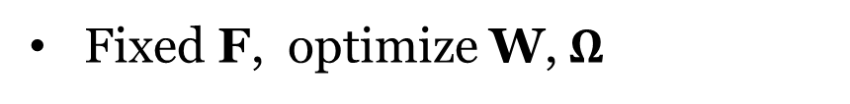
Similarity-aware FL – Alternating optimization
Fixed F, optimize W,$Ω$
node update W:
server update$U,Ω$:

Slide 19
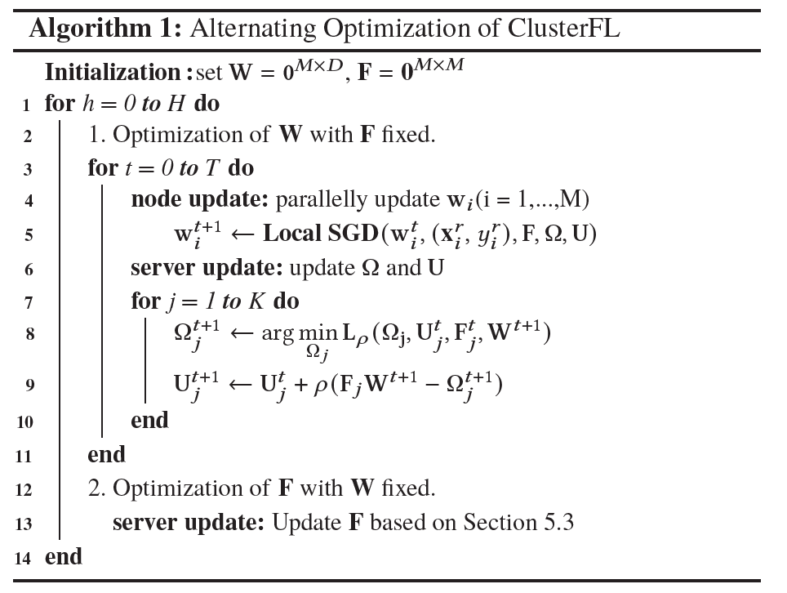
Similarity-aware FL

Slide 20
Similarity-aware FL Framework
Similarity-aware FL framework
How to identify clusters
How to update model
Communication Efficiency
How to handle straggler
How to identify “important” nodes

Slide 21
Similarity-aware FL Framework
Communication Efficiency
How to handle straggler
How to identify “important” nodes
Idea: leverage cluster structure to drop the nodes while keep the similar accuracy

Slide 22
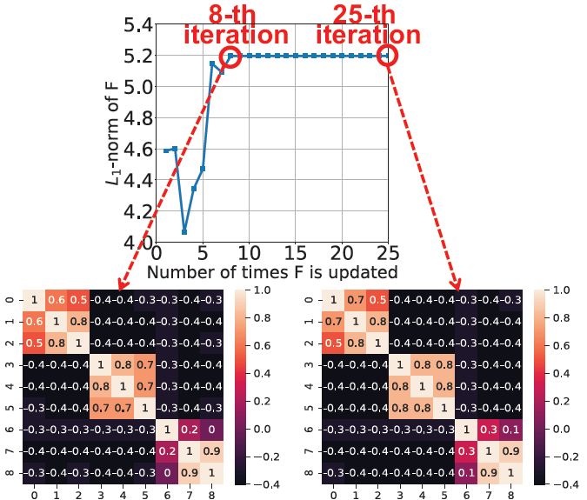
Optimizing Communication Performance
The cluster relationship can be learned in the early stage.
F

Slide 23
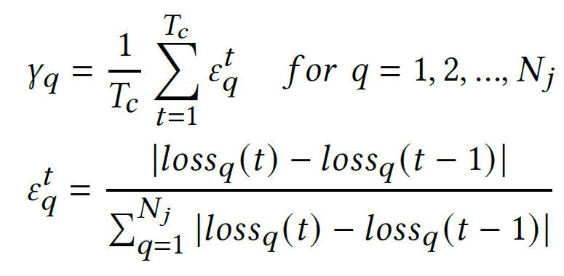
Optimizing Communication Performance
Drop the cluster-wise stragglers (the nodes who converge slower)
According to cluster structure F, we can measure the cluster-wise convergence performance:
$T_{c}$: the threshold of iteration for determining stragglers at each cluster

Slide 24
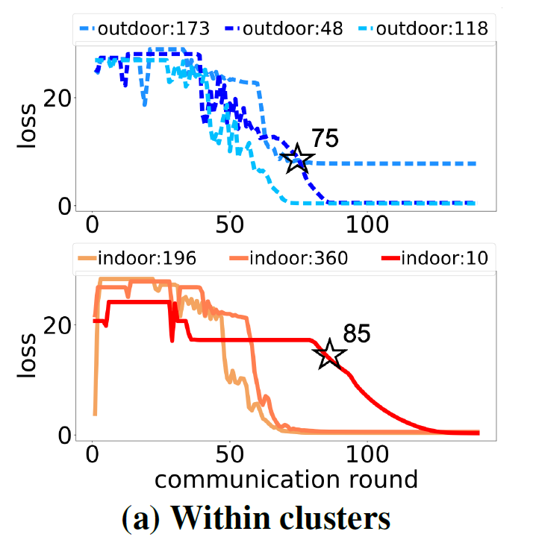
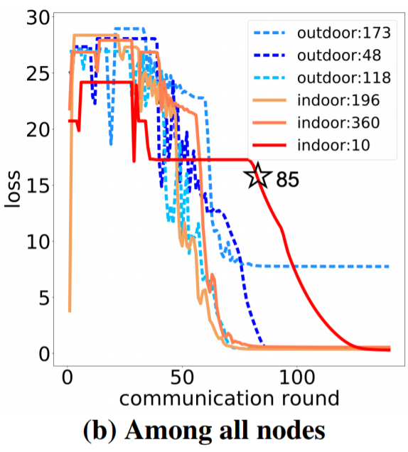
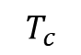
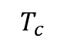
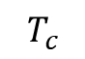
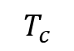
Optimizing Communication Performance
Drop the cluster-wise stragglers (the nodes who converge slower)
$$T_{c}$$
Cluster 1
$$T_{c}$$
$$T_{c}$$
$$T_{c}$$
Cluster 2
More dynamic and flexible
Notes:
Instead of dropping straggler from all the nodes, we can drop the straggler in cluster wise

Slide 25
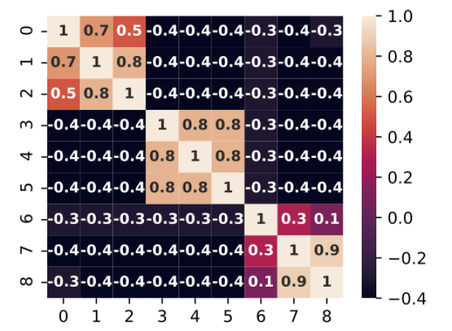
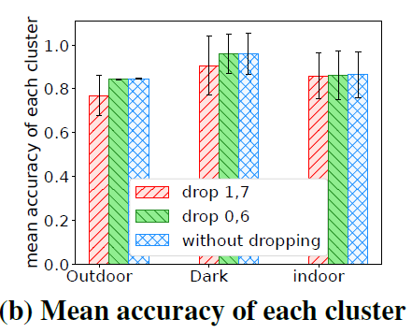
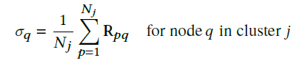
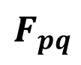
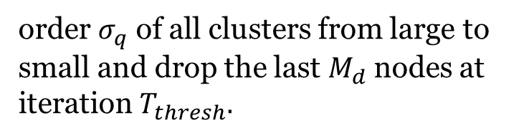
Optimizing Communication Performance
Drop nodes whose data is less related to other nodes in the same cluster.
Node 0 has weaker correlations in the first cluster. (Outdoor)
Node 1 has stronger correlations in the first cluster.
$$F_{pq}$$
order $σ_{q}$ of all clusters from large to small and drop the last $M_{d}$nodes at iteration $T_{thresh}.$

Slide 26
Outline
Motivation
Similarity-aware federated learning framework
Experimental Results
Conclusion

Slide 27
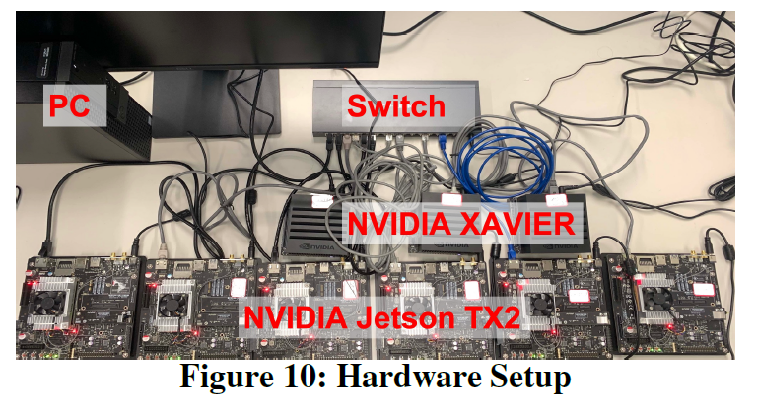
Experiment Setup
The server and nodes are connected via a TP-link TL-SG2016K switch.
The power are measured via the on-board power monitoring sensor TIINA3221x.

Slide 28
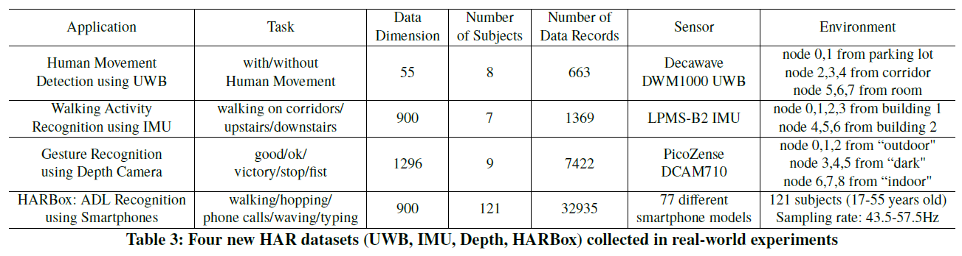
Experiment Setup
Dataset: four new human activity recognition (HAR) datasets
Models: SVM for human movement detection;
Five-layer NN for walking activity recognition;
Five-layer CNN for depth camera gesture recognition.

Slide 29
Experiment Setup
Baseline:
Local training
Federated average¹ (FedAvg)
Federated transfer learning² (FTL)
Centralize (single) model training
¹McMahan Communication-Efficient Learning of Deep Networks from Decentralized Data, 2017
2 Feng et alPmf: A privacy-preserving human mobility prediction framework via federated learning. 2019

Slide 30
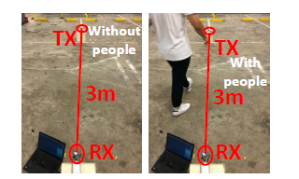
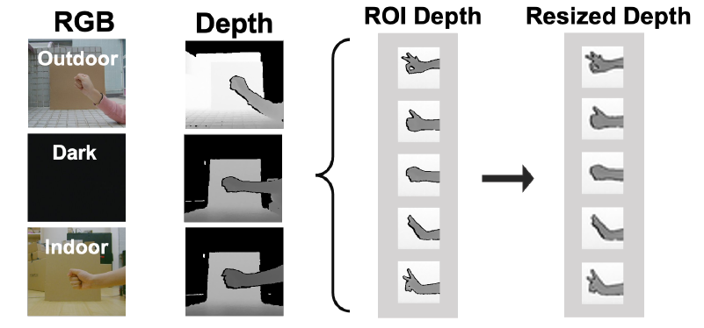
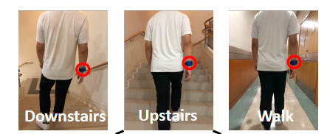
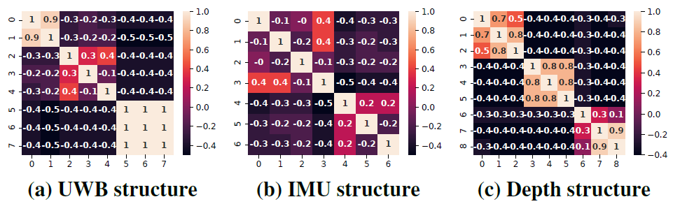
Visualization of Different Datasets
multi-path effect of Ultra Wide Band signals
Sensor data from smart watch
Camera image data

Slide 31

Performance on Different Datasets
ClusterFL outperforms Local/FedAvg/FTL in model accuracy.
For the IMU dataset, ClusterFL has the best performance in model accuracy.

Slide 32

Performance on Different Datasets
ClusterFL can reduce more than 20% communication latency while maintaining almost the same accuracy performance.

Slide 33

Performance on Model Depths
IMU dataset
When the model becomes deeper, the accuracy of all methods tends to increase.
ClusterFL has a more “stable" accuracy performance under different learning models

Slide 34

Performance on the scalability of ClusterFL
When the number of nodes increases, the mean accuracy of centralized learning slightly decreases, suggesting the heterogeneity of user’ data.
ClusterFL has a significantly smaller variation of accuracy among nodes and save more than 50% communication time.

Slide 35
Conclusion
ClusterFL features a novel federated learning framework enabling collaborative learning among similar nodes
ClusterFL integrates two effective communication optimization mechanisms based on the learned cluster structure.
ClusterFL outperforms several learning paradigms and reduce more than 50% communication latency

